Slide 1

Email : biganzapappy@gmail.com
Tel : + (250) 785029694

Slide 2

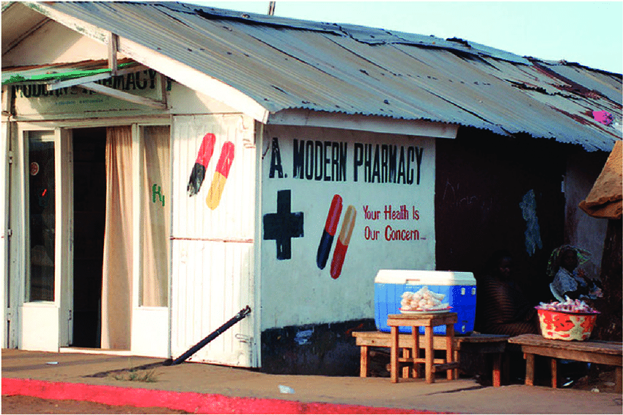

Problem
High Cost of Medications
Limited Availability of medications /Lack of accessibility of pharmacy in rural areas
AFIA brings affordability and convenience and there is no such website yet available in Rwanda

Slide 3

Solution
Afiapharma is a pharmaceutical E-commerce platform
there by enabling users to get 20 % discount price on their medicines at home with only few clicks
Certified Online pharmacy by Rwanda FDA, on a mission to make quality medications affordable, easily accessible and available to billions people across Africa

Slide 4
Market Size
$ 20 Bn
Prescription filled per month in 1 retail pharmacy 1500
Total Retail Pharmacies in Rwanda 470
The Africa Pharmaceutical Market was $ 20 billion in 2015 reported by AFRICAN DEVELOPMENT BANK ,the Growth will be worth $ 70 billion by 2030 ,we aim to capture 3% of this the next five years ,
The Rwandan Pharmaceutical sales was $ 165 million in 2020 ,expected to grow at a CAGR of 11,4 % 2025 to reach $ 265 million and a CAGR of 11,6 % by 2030 to reach a value of $ 426 million, reported by United Nations Comtrade Database

Slide 5
Target Market
1. Primary Customer : People with chronic disease
On a monthly basis they need to refill their prescription and most of them are in old ages who find it hard to move to multiple pharmacies.
Cardiovascular Disease: 2010 WHO estimates in Rwanda, 22 % of adults aged 18 years old and above were hypertensive.
13 % Chronic respiratory diseases: Asthma ,Chronic Obstructive Pulmonary disease ,Sinusitis
Diabetes: the prevalence of diabetes in Rwanda is about 3 % (390,000)of the population
Affordability & convenience for chronic patients
2. Secondary Customers : People in Rural areas
In Rwanda, we have 470 pharmacies, more than 75% of them are currently located in urban areas.
Those people who moves distances from Rural areas to look for medications that they didn’t get from the nearest pharmacies , the Rwanda rural population for 2019 was 10 millions which is % 80 in the current population of Rwanda which is 13 million reported by National Institute of Statistics of Rwanda .
Affordability & convenience for rural customers

Slide 6
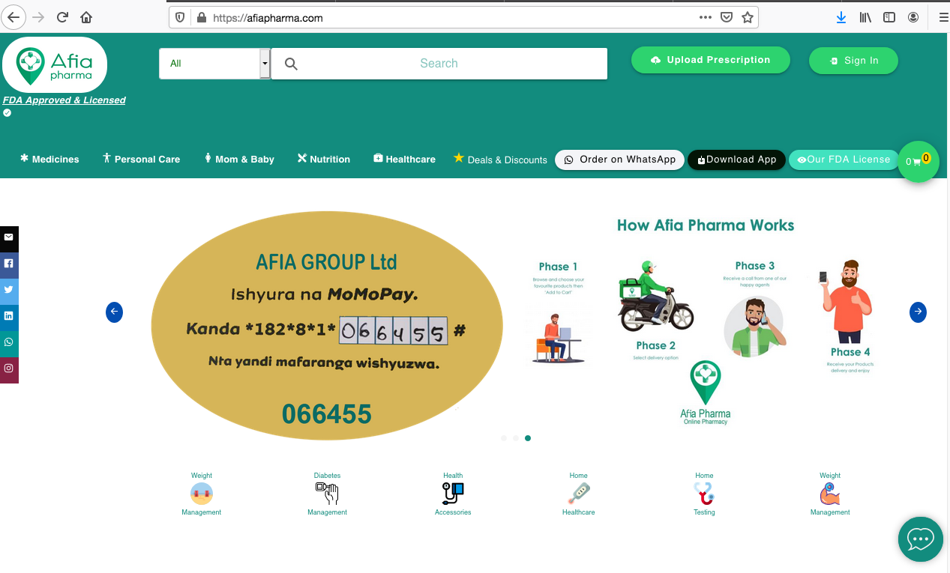
Product
Web based application, E-Prescription, Mobile Application
Mobile App
Website

Slide 7
6. Competitive Advantages
Discount up to 20% on medications & cosmetics
Homedelivery services
24/7 availability. Wide range of over 4,000 SKUs
Powerful search engine including spellcheck
App will include reminders for chronic Disease
Our Digital pharmacists can be consulted with discretion,
this is appreciated by consumers buying products such as Viagra or condoms
Affordability
Convenience
Privacy

Slide 8


Our African Competitors
Afia Pharma is offering patients savings in both time and money
$3M, Series A, 2020
$3M, Series A, May 2019
$1M Series A, May 2019
$17M, Series C ,May 26 2020

Slide 9
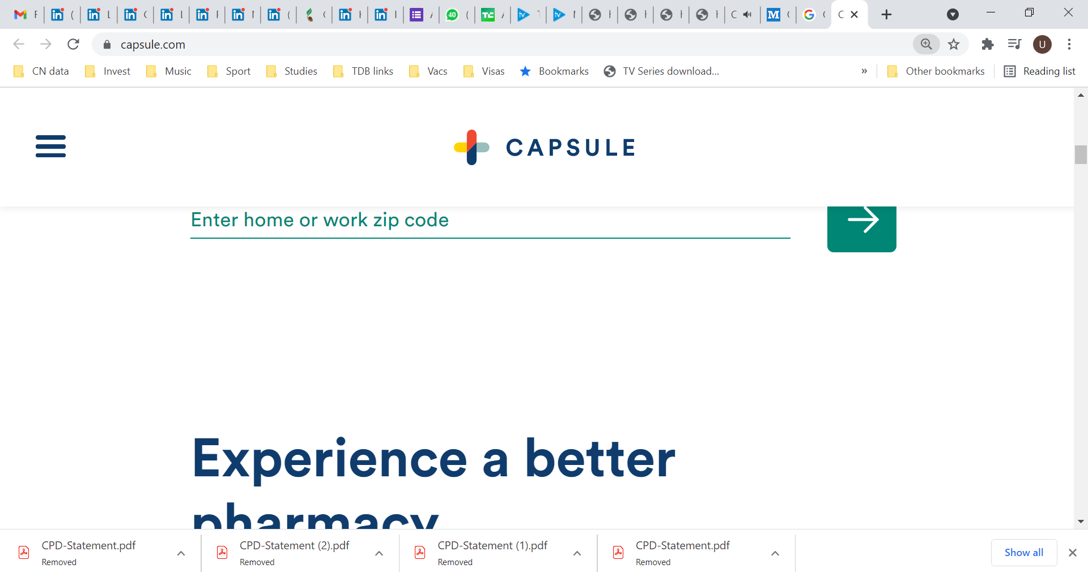

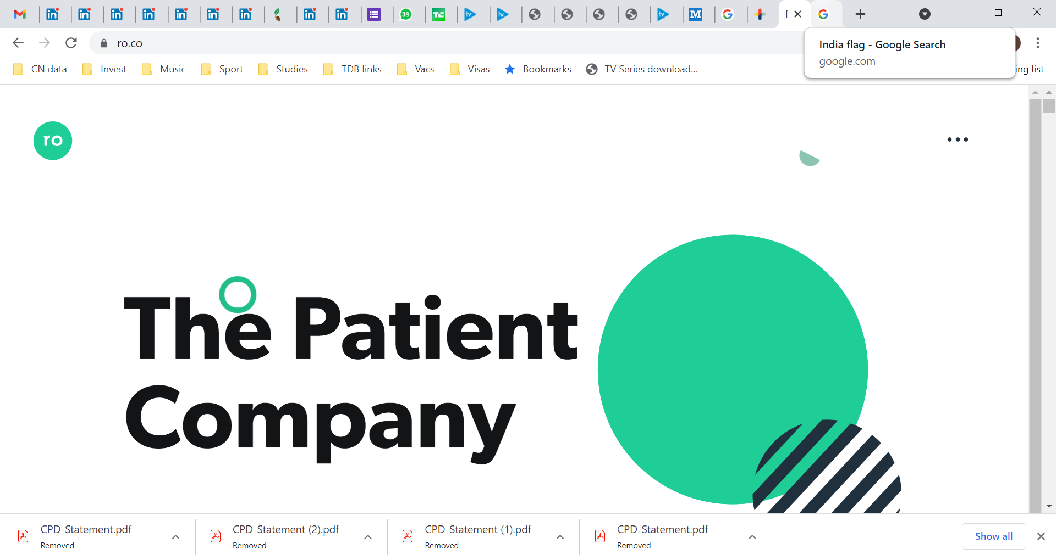




Global peers – strong appeal in e-pharma and e-health
$1B Valuation, 2021
Online prescription with same day delivery
$5B Valuation, 2021
Telehealth and online pharmacy
IPO targeted at $3B, 2021 bought rival Medlife
Online pharmacy
$213M Valuation, 2020
Online pharmacy
Acquired by Amazon $1B, 2019
Online pharmacy

Slide 10
Afia Pharma Traction

Slide 11
Customer Acquisition Channels
Customer Acquisition Cost = $ 1.9
Customer Lifetime Value = $ 43
Average Order Value = $ 18
Net Margin = 20% = $ 4
B2C Channels
B2B Channels
Social Media
Accelerated user growth
Facebook
Google
SMS bulk & emails
Instagram
Traditional media
Press, TV
Radio
Partnerships with Clinic and Hospitals
Seamless deliveries
Effective inventory management
Partnerships with Health Insurance
Reduce medicine costs and evaluation
Improve service to their clients

Slide 12
Business Model
Afiapharma focuses on making the consumer’s life much easier by saving both time and money
$$$
$$
$
We charge the consumer a delivery fee $1 and $2 in Remote Locations of Rwanda ,
Commission from the medications sales and health equipment on Index of 1.3,Net Margin is 20% = $ 4 with on Average Order Value of $ 18
We will also charge 8% weekly on a subscription based plan for any commercial partnership based on order volume

Slide 13
Revenue Forecast
We expect to reach profitability by our third year 2023 and will generate substantial sales by year three
Lifetime Value: $ 43
The Average Order Value: $ 18
The Customer Acquisition Cost : $ 1.9
Net Margin : 20 % = $ 4
Since January 2021 we generated 1,278 sales Orders
Target to ramp up deliveries to 80 orders a day on the back of investments in marketing and logistics
 | 2021 | 2022 | 2023
Orders Revenue | 2,500 | 12,500 | 62,000
 | $ 45,000 | $ 225,000 | $ 1,125,000
Net Margin | $ 9,000 | $ 45,000 | $ 225,000

Slide 14
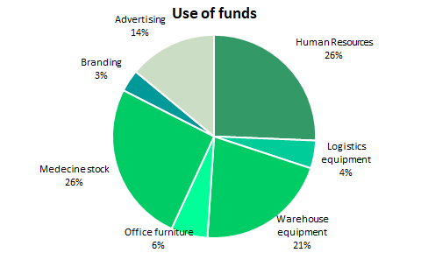

Fundraising – USD 100,000
Funds will support expansion efforts
The founders invested $ 28,000 in the business end of 2020
They will own 90% of the company after the raise
Business Angels Rwanda invested 12,300 US$
Raising: $100,000-150,000 USD Dollar

Slide 15
Management Team
Papy BIGANZA
Chief Executive Officer
BSc, Computer Engineering at KIST, Rwanda
GEMEYA, East African E-marketplace/Head of Marketing
30 % Equity
Alexandre NTWALI
Chief Operating Officer
BSc, Chinese Language and Literature at San Yat Sen University/China Founded Asiafrica Logistics ltd 2019
30 % Equity ,Invested $ 10,000 in Pre-seed stage
Stephanie UMUHIRE
Chief Pharmacist
BSc, Pharmacy ,
Pharmacie de la Canche
Canisius GAKIZA
Co-Founder and CTO
MSc, School of Information Science and Engineering, XIAMEN University China
Data Analyst & Business Strategist Center for Innovation Rwanda ,10 % Equity
Clemence Uwase
Finance Controller
MBA ,International Business ,Lovely Professional University ,INDIA
Working on SOMA UMENYE USAID Project as Financial assistant
Patrice BUCYANA
Digital Marketer,
SEO, Social media Mgt, Data analysis
BSc Public Health at JOMO KENYATTA UNIVERSITY/Nairobi, Kenya
Data Collector, Rwanda Biomedical Center/RBC
Pursuing Digital Marketing Online course/NM-AIST University
Musana Emile
Member of Advisory Board
Chief Executive Officer ,Elite Networks DRC
Invested $ 5,000 for 30 % in Pre-seed stage

Slide 16
15. Mentorship Programs and Incubators
1. The 2021 Cohort of the TONY ELUMELU Entrepreneurship Program
2 . NORRSKEN EAST AFRICA
3 . Incubatees in THE ZONE VIRTUAL ENTERPRISE HUB
4 . BID CAPITAL Partners
5 . 2021 ALIBABA Netpreneur Training Online Program ,the cohort
6 BPN Rwanda
7 Accelerate 2030 Rwanda

Slide 17
Contact Us
We are fundraising
Let’s talk: biganzapappy@gmail.com

Slide 18
ANNEXES

Slide 19
USE OF FUNDS BREAKDOWN DETAILS
Human Ressource
Item | Description | Unit | Amount USD
Pharmacist | Licensed Pharmacist | 1 | 5,000
Nurse | Licensed Nurse | 1 | 2,500
Driver | Professional driver | 1 | 1,500
Accountant | Professional accountant | 1 | 2,000
Transportation
Item | Description | Unit | Amount USD
Motorcycle delivery | Motorbike | 1 | 1,500
 | Cold chain equipment | 1 | 100
 | Fuel | 1 | 300
Infrastructures
Item | Description | Unit | Amount USD
 | Lightening pharmacy shelf | 1 | 2,500
 | Fridge | 1 | 1,000
 | Internet Bundle for 6 months | 1 | 800
 | HP Computer, I5 | 1 | 1,500
 | Ishyiga software for 6months | 1 | 600
 | Digital water dispenser | 2 | 200
 | House rent for 6 months | 1 | 2,400
Back office furniture | Office laptop | 1 | 1000
 | Printer and accessories | 1 | 1000
 | Camera | 1 | 500
Initial medicines stock | Para Pharmaceuticals |  | 3500
 | Medicines |  | 5000
 | Consumables |  | 2500
Marketing and branding
Branding | Pharmacy sign post |  | 500
 | Motorbike branding |  | 200
 | Packaging branding |  | 500
 | Employees uniform |  | 300
Marketing | Facebook Ads |  | 1000
 | Instagram Ads |  | 2000
 | Google Ads, |  | 1000
 | Radio Ads |  | 1000
 | Influencers |  | 1000
Total |  |  | 100,000 USD

